Slide 1
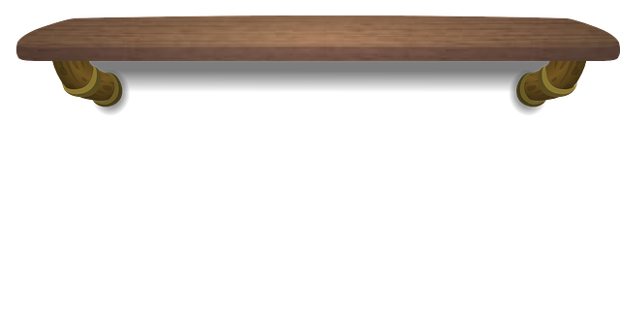
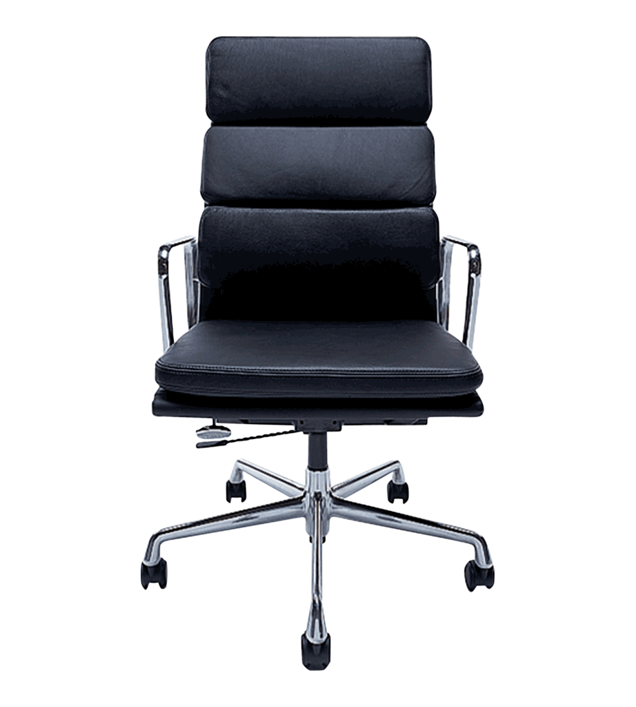
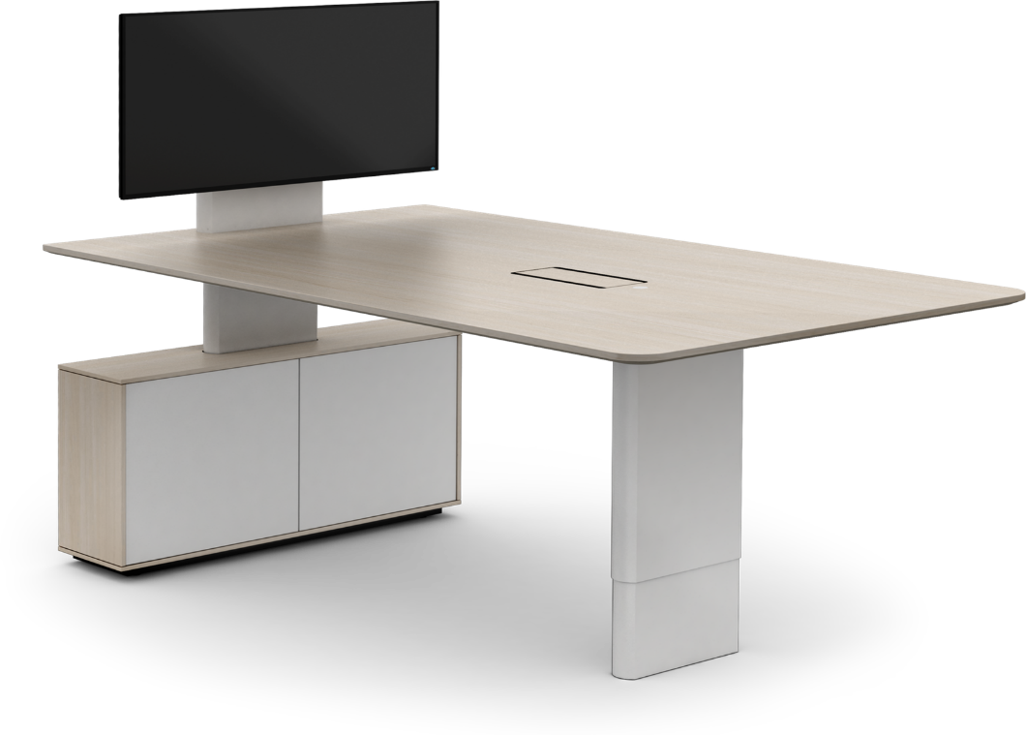
Welcome to Personal Finance
Class Meeting Times
Objectives
A Day (4th): 1:35 pm – 2:20am
B Day(6th): 9:55 am – 10:40am
This course is based on the Missouri Personal Finance Competencies and presents essential knowledge and skills to make informed decisions about real world financial issues.
Hi!
Click on your class meeting time to access our classroom.
Class Expectations

